Slide 1
Quick Analysis of NFL Draft Data using Arules Package in R
Saad Yousef
(Twitter: SaadDataSci; GitHub: snyousef)
Job Seeker in Predictive Analytics, Data Analytics, Data Science

Slide 2
Description
Took all draft data from years 2014-2018 and pared data down to four attributes:
NFL Team (Arizona Cardinals, Dallas Cowboys, etc.)
NCAAF Team (Alabama, Texas, etc.)
NCAAF Team’s Conference (ACC, Big 12, etc.)
Player Position (WR, QB, etc.)

Slide 3
Objective
Look for patterns in team’s drafting habits. For example:
Do certain NFL teams draft more players from a school than any other school?
Do certain NFL teams draft more players from a conference than any other school?
Do certain NFL teams draft more players at one position than any other team?
Do players of a certain position come from one conference more than another?

Slide 4
Exploratory Data Analysis

Slide 5
Initial Observations
SEC (surprise) is conference with most people drafted (then came ACC, Big Ten, Pac-12, Big 12 in that order)
School with most draftees is…Alabama (surprise)
Position player most often picked was WR

Slide 6
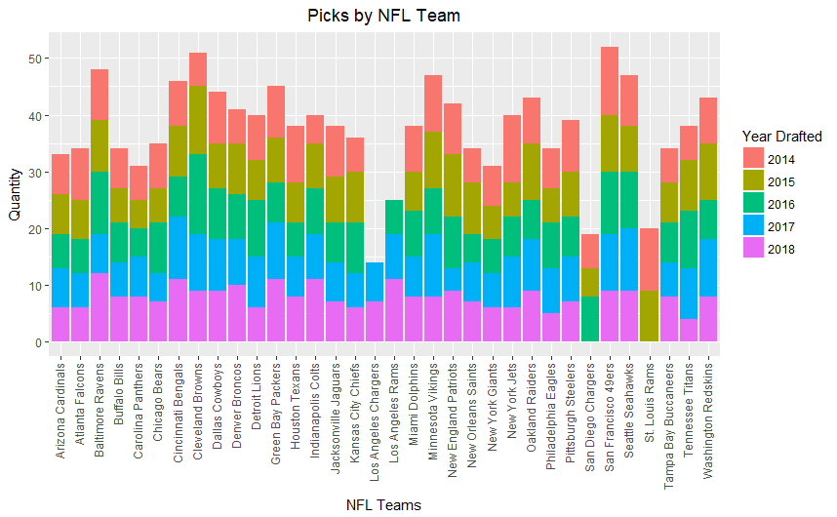
Picks per NFL Team

Slide 7
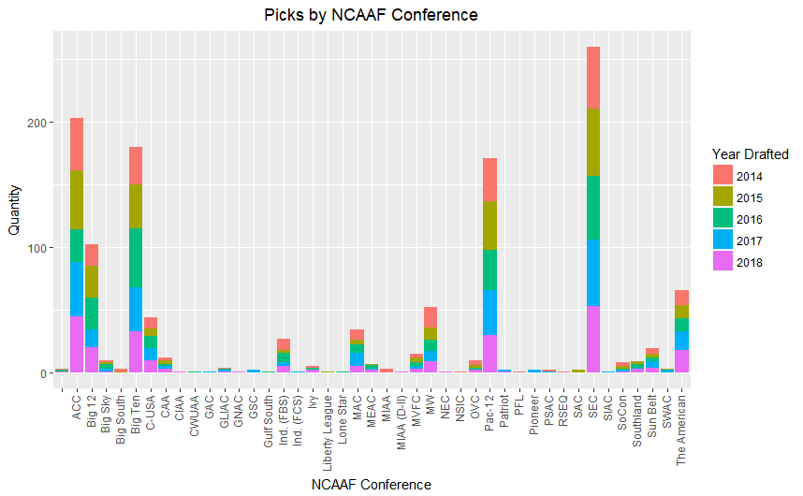
Picks from each NCAAF Conference

Slide 8
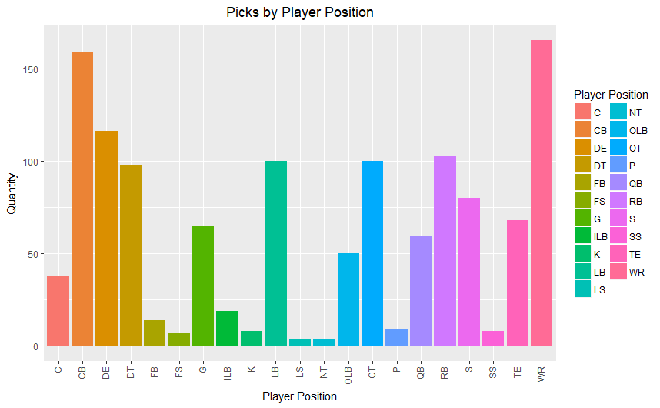
Picks by Player Position

Slide 9
Arules Package: What does it do?
Find associations between within customer transaction data. Apriori algorithm finds rules (i.e.: if A happens, then B happens this often)
For this scenario, what patterns can we find in NFL draft data
Terms to know:
Support: Number of times item appears in ‘transaction’
Confidence: Ratio of rule items to rule items plus other items (i.e.: {A,B}/{A,B,…}
Lift: Multiplicative likelihood that item on right hand-side of rule will be ‘purchased’ when item in left-hand side is ‘purchased’
Count: Number of times rule items show up together

Slide 10
Findings
Atlanta Falcons and Indianapolis Colts were more likely to draft linebackers than any other position and more likely than any other team to draft linebackers
Safeties were likely to com from ACC or Alabama
ACC players were either Safety or drafted by Buffalo Bills
Running backs were more likely to come from SEC

